Slide 1
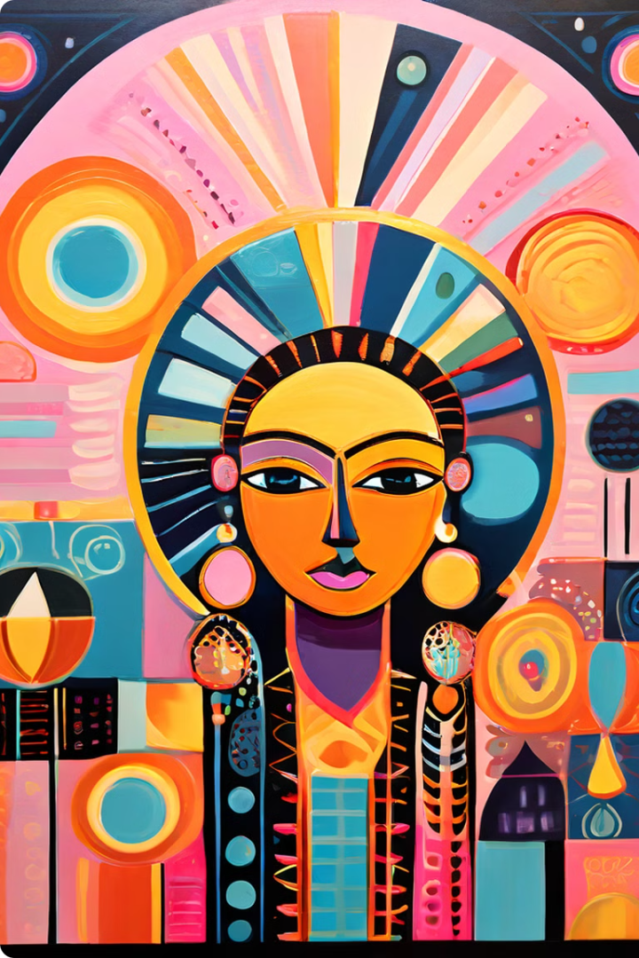
Religion in African Culture
Religion plays a fundamental role in African culture, deeply influencing the social, political, and economic aspects of life. African traditional religions, Christianity, and Islam are the primary religious expressions on the continent, each shaping the cultural landscape in unique ways.
Rachael Mawia

Slide 2

African Traditional Religions
African traditional religions, often referred to as "indigenous religions," are diverse and rich in practice, encompassing a vast array of beliefs, rituals, and deities. They are closely intertwined with the natural world, emphasizing reverence for ancestors and spirits.
Spirituality
Community
Belief in a supreme being, along with a host of lesser deities and ancestral spirits, is a core element of African traditional religions.
Traditional religions often serve as the foundation of social cohesion, providing a framework for community gatherings and celebrations.
Nature
Rituals
A strong connection to nature is evident, with veneration of natural elements, such as mountains, rivers, and trees.
Rituals and ceremonies are essential for connecting with the spiritual realm and seeking guidance and blessings.

Slide 3

Belief in Spirits and Deities
These beliefs are often expressed through a complex system of rituals, ceremonies, and offerings. The spirits are believed to influence various aspects of life, including health, fertility, and prosperity. These beliefs are often expressed through a complex system of rituals, ceremonies, and offerings.
1
Supreme Being
Most traditional religions acknowledge a supreme being, often referred to as "God" or "Creator," who is seen as the ultimate source of power and authority.
2
Lesser Deities
In addition to the supreme being, traditional religions often recognize a pantheon of lesser deities, each associated with specific aspects of life, such as rain, agriculture, or healing.
3
Ancestral Spirits
Ancestors play a significant role in many African traditional religions, believed to possess wisdom and power that can be accessed through rituals and offerings.
4
Spirit World
The spirit world is seen as an integral part of the living world, with spirits believed to interact with humans in various ways, influencing their lives and destinies.

Slide 4





Importance of Ancestors
Ancestors are revered as intermediaries between the living and the spirit world, offering guidance, protection, and blessings to their descendants. This reverence for ancestors is manifested in various rituals and practices, such as ancestor veneration, ancestral shrines, and the preservation of oral traditions.
Family Ties
Ancestral veneration reinforces the bonds of family and community, creating a sense of belonging and shared history.
Wisdom and Guidance
Ancestors are believed to possess vast wisdom and knowledge, providing guidance and support to their descendants in times of need.
Protection and Blessing
Ancestors are also believed to offer protection against harm and misfortune, ensuring the well-being of their descendants.
Preservation of Traditions
Ancestral stories and traditions are passed down through generations, preserving cultural identity and heritage.

Slide 5
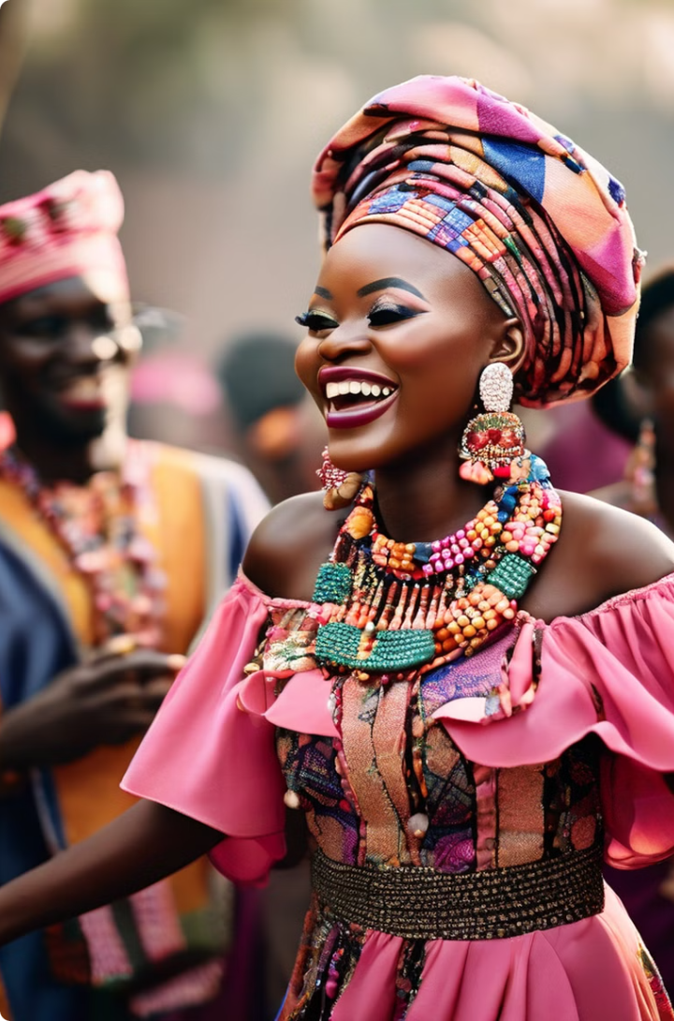




Rituals and Ceremonies
These rituals are often elaborate and involve music, dance, drumming, storytelling, and offerings. They provide opportunities for community gatherings, fostering social cohesion and strengthening cultural bonds.
Birth Ceremonies
These ceremonies celebrate the arrival of a new life, welcoming the child into the community and seeking blessings for its future.
Marriage Ceremonies
Marriage rituals often involve elaborate ceremonies that symbolize the union of two families and the continuation of lineage.
Death Ceremonies
These ceremonies honor the deceased, ensuring a smooth transition into the afterlife and maintaining a connection between the living and the ancestors.
Harvest Festivals
Harvest festivals are celebrations of abundance, expressing gratitude to the deities and spirits for bountiful crops and ensuring prosperity.

Slide 6
Christianity in Africa
Christianity has had a profound impact on the African cultural landscape, shaping the values, beliefs, and practices of millions of people. It has also influenced the development of education, healthcare, and other social institutions.
Spread of Christianity
African Christianity
Influence on Society
Christianity first arrived in Africa during the early centuries, spreading through missionary efforts and through interactions with European traders.
African Christianity has evolved to incorporate indigenous beliefs and practices, resulting in unique forms of worship and spirituality.
Christianity has played a significant role in social and political life, influencing education, healthcare, and other aspects of society.
Syncretism
Education
Missionaries
Spirituality
Healthcare
Trade
Cultural Expression
Social Change
Education

Slide 7

Influence of Islam
Islam is another major religion in Africa, with a significant presence in North Africa, East Africa, and parts of West Africa. It has influenced cultural practices, social norms, and the development of legal systems and education.
Trade and Migration
1
Islam arrived in Africa through trade routes and migration patterns, spreading gradually across the continent.
2
Cultural Impact
Islam has influenced various aspects of African culture, including art, architecture, music, and clothing.
Education and Law
3
Mosques have traditionally served as centers of education, promoting literacy and religious knowledge, influencing legal systems and social structures.
4
Social Cohesion
Islam has contributed to the development of strong social communities, fostering a sense of unity and shared identity.

Slide 8

Interplay of Religions
The interplay of African traditional religions, Christianity, and Islam has shaped the religious landscape of the continent, creating a tapestry of beliefs and practices. This coexistence has led to both assimilation and resistance, resulting in a complex and dynamic religious landscape.
Syncretism
The blending of different religious beliefs and practices, often seen in African traditional religions, Christianity, and Islam.
Religious Pluralism
The acceptance and tolerance of multiple religious traditions within a society, reflecting the diversity of religious beliefs in Africa.
Cultural Exchange
The interaction between different religious groups has led to the exchange of ideas, practices, and cultural expressions.
Social Cohesion
Despite religious differences, religious institutions often play a vital role in promoting social cohesion and community engagement.

